Slide 1
Interesting case
R2 สริตา จินาวงศ์
อ. นวลวรรณ ภูวโชติโรจนโภคิน

Slide 2
Interesting case
Case : 21 year-old Thai male patient
Diagnosis : Serotonin syndrome with brain death
Operation : Harvest organ

Slide 3
Chief complaint
ซึมลง 30 นาที ก่อนมารพ

Slide 4
R1 history

Slide 5
History
21 year-old Thai male patient : U/D MDD
Current medication : Fluoxetine (20) 1 x 2 po pc, Lorazepam (2) 2 x 1 po hs
Chief complaint : ซึมลง 30 นาที ก่อนมารพ
Present illness :
18/10/64 ผู้ป่วยมีประวัติทานยา Fluoxetine 120 เม็ด เวลา 17:00 น
19/10/64 06:00 มีผู้พบเห็นผู้ป่วยซึมลง พูดไม่ชัด ลิ้นแข็ง จึงได้นำส่งรพ
At ER 06:30 V/S : BP 105/58 mmHg, RR 16 /min, BT 40 C, PR 98 bpm, E4V5M6, Pupil 4 mm RTLBE
Time | Clinical | Management
06:40 | 1st GTC | Valium IV
07:30 | 2nd GTC | Dilantin 750 mg IV load and Intubate
08:34 – 08:50 | PEA | ADR x III and CPR x 10 min -> ROSC

Slide 6
History
ROSC :
V/S BP 70/30 mmHg, PR 40-50 bpm
EKG : NSR c LBBB rate 90 bpm
Management :
ETT No. 8.0, depth 22 cm
NSS LOAD 2,000 ml IV
Acetar 1,000 ml IV
Dopamine (2:1) IV rate 5 ml/hr (3.5 mcg)/kg/min)
Levophed (1:25) IV rate 10 ml/hr (0.1 mcg/kg/min)
Cypoheptadine 3 tab load then 2 tab po q 12 hr
Ceftriaxone 2 g IV
Refer to PMK hospital

Slide 7
Active problems
Diagnosis :
Severe serotonin syndrome
AKI with rhabdomyolysis with metabolic acidosis with polyuria with hypernatremia -> Resolved
Stress-induced cardiomyopathy -> Resolved
Neurogenic pulmonary edema
Brain edema with tonsillar and uncal herniation S/P Bicoronal craniectomy (22/10/64) -> DECLARE Brain death 26/10/2564

Slide 8
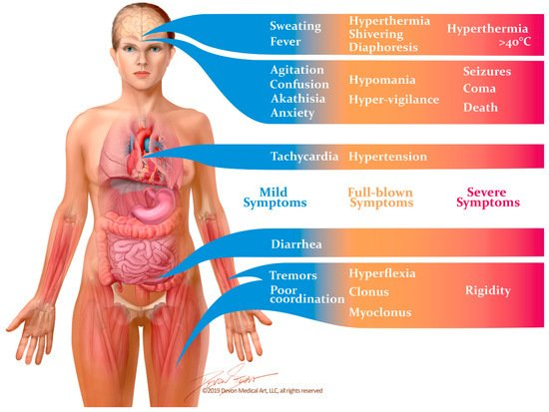
Serotonin syndrome

Slide 9
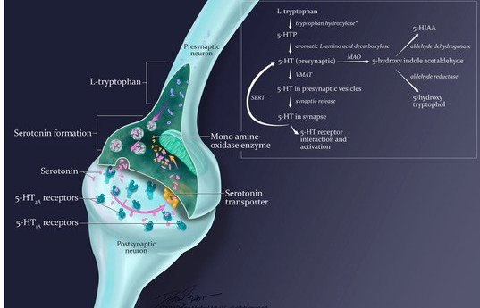
Serotonin syndrome

Slide 10
Past history
ปฎิเสธประวัติสูบบหรี่ และ ดื่มเหล้า
ปฎิเสธประวัติแพ้ยา แพ้อาหาร
มีประวัติผ่าตัดไส้ติ่งเมื่อ 6 ปีก่อน ไม่มีภาวะแทรกซ้อน
ปฎิเสธโรคพันธุกรรมในครอบครัว

Slide 11
R1 Physical examination & investigation

Slide 12
Physical examination
V/S : BT 36 C, PR 66 bpm, RR 20 /min, BP 152/92 mmHg
BW 60 kg, Ht 175 cm, BMI 19.6 kg/m²
GA : Comatosed, normosthenic built, on endotracheal tube
HEENT : Moderately pale conjunctivae, anicteric sclerae
Lung : Clear, equal breath sound both lungs
Heart : Normal S1, S2 no murmur
Abdomen : Soft, not tender, no abdominal distension, normoactive bowel sound
Ext : No pitting edema

Slide 13
Physical examination
Neuro : E1VTM1, pupil 8 mm fixed dilate BE, not response to pain stimuli, doll’s eye negative, corneal reflex negative, cough reflex negative, motor grade 0 all extremities, clonus positive negative, BBZ absent both, stiff neck negative

Slide 15
Prerequisites
Coma, irreversible, and cause known
Neuroimaging explains coma
CNS-depressant drug effect absent
No evidence of residual paralytics
Absence of severe acid-base, electrolyte, and endocrine abnormality
Normothermia (core temperature > 36°C)
SBP > 100 mm Hg
No spontaneous respirations

Slide 16
Examination
Pupils nonreactive to bright light
Corneal reflex absent
Oculocephalic reflex absent
Oculovestibular reflex absent
No facial movement to noxious stimuli at supraorbital nerve, temporomandibular joint
Gag reflex absent
Cough reflex absent to tracheal suctioning
Absence of motor response to noxious stimuli in all four limbs

Slide 17
Apnea testing
Patient is hemodynamically stable
Ventilator adjusted to provide normocarbia
Patient preoxygenated with 100% Fio2 for > 10 min to Pao2 > 200 mm Hg
Patient well-oxygenated with PEEP 5 cm H2O
Provide oxygen via a suction catheter to the level of the carina at 6 L/min or attach T-piece with continuous positive airway pressure at 10 cm H2O
Disconnect ventilator
Spontaneous respirations absent
Arterial blood gas drawn at 8–10 min, patient reconnected to ventilator
Pco2 > 60 or 20 mm Hg rise from normal baseline value

Slide 18
Apnea testing
Patient is hemodynamically stable
Ventilator adjusted to provide normocarbia
Patient preoxygenated with 100% Fio2 for > 10 min to Pao2 > 200 mm Hg
Patient well-oxygenated with PEEP 5 cm H2O
Provide oxygen via a suction catheter to the level of the carina at 6 L/min or attach T-piece with continuous positive airway pressure at 10 cm H2O
Disconnect ventilator
Spontaneous respirations absent
Arterial blood gas drawn at 8–10 min, patient reconnected to ventilator
Pco2 > 60 or 20 mm Hg rise from normal baseline value

Slide 19
Ancillary testing : only 1 test needs to be performed
Cerebral angiogram
Hexylmethylpropylene amineoxine single-photon emission CT
Electroencephalography
Transcranial Doppler ultrasonography
Time of death (MM/DD/YY) _______________________
Name of physician and signature ____________________

Slide 20
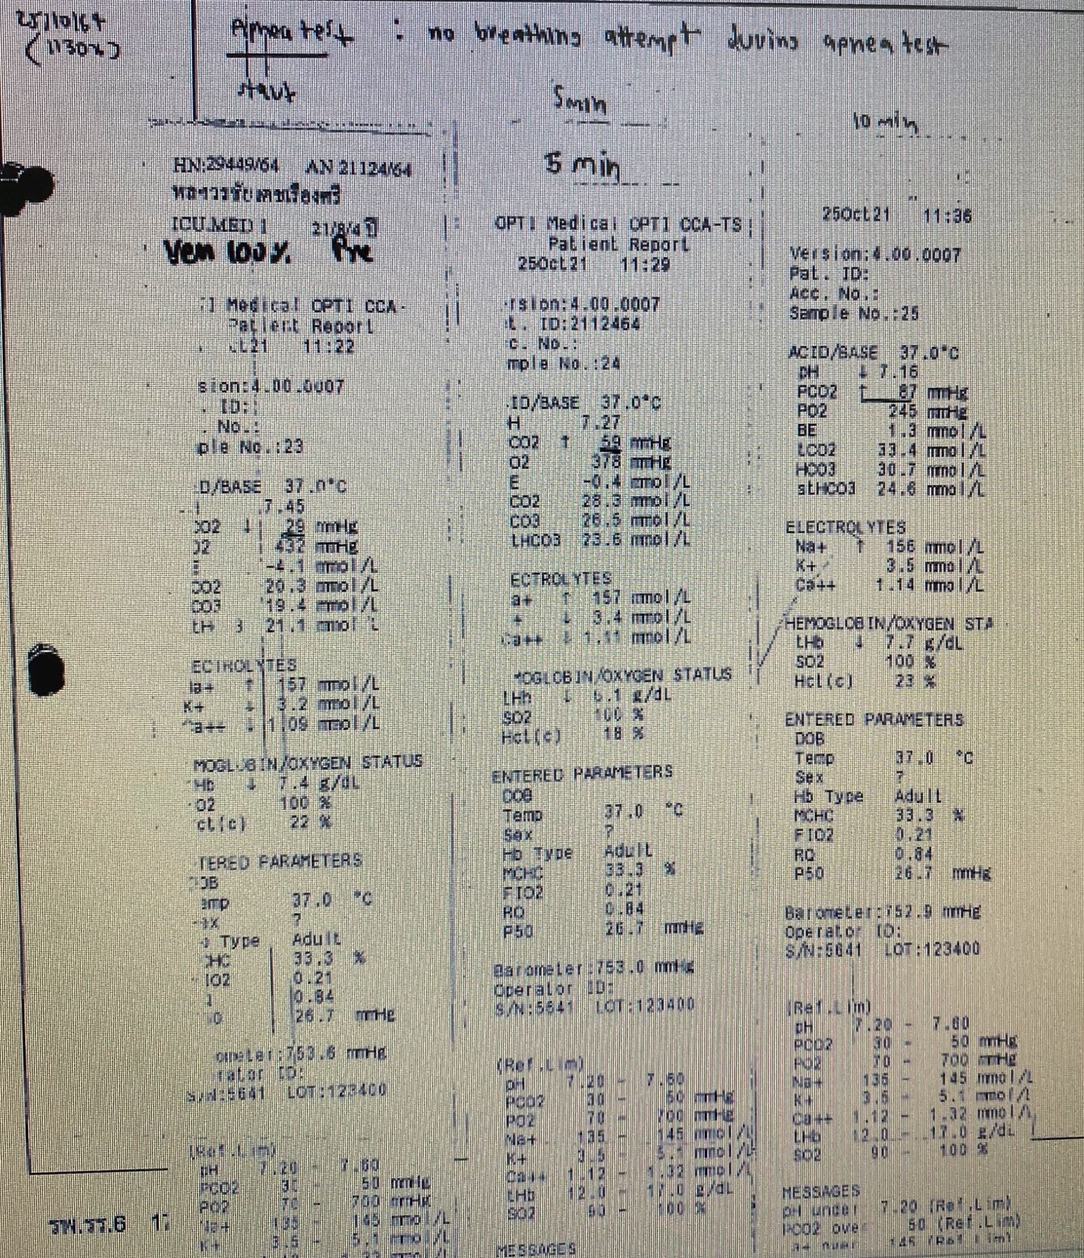
Apnea test

Slide 21
Investigation

Slide 22
Laboratory tests
Complete blood count
Serum electrolytes, BUN, and creatinine
Liver function tests
Urinalysis
Arterial blood gas (ABG)
PT/INR and aPTT/ ratio
Blood, sputum, and urine cultures

Slide 23
Infectious disease testing
HIV antibody (anti-HIV) donor screening test or HIV antigen/antibody (Ag/Ab) combination test
HIV RNA nucleic acid amplification test (NAT)
Hepatitis B surface antigen (HBsAg) donor screening test
Hepatitis B core antibody (anti-HBc) donor screening test
Hepatitis B DNA NAT
Hepatitis C virus antibody (anti-HCV) donor screening test
Hepatitis C RNA NAT
Cytomegalovirus antibody (anti-CMV) donor screening or diagnostic test
Epstein-Barr virus antibody (anti-EBV) donor screening or diagnostic test
Syphilis donor screening or diagnostic test
Toxoplasma immunoglobulin G (IgG) antibody test

Slide 24
Additional organ-specific testing
Echocardiography : potential heart donors
Cardiac catheterization : older heart donors (>40 years) or those with significant risk factors for coronary heart disease.
Fiber optic bronchoscopy & CT chest : potential lung donors.
A percutaneous liver biopsy : liver donors with obesity, positive testing for HCV, or history of alcoholism.

Slide 25
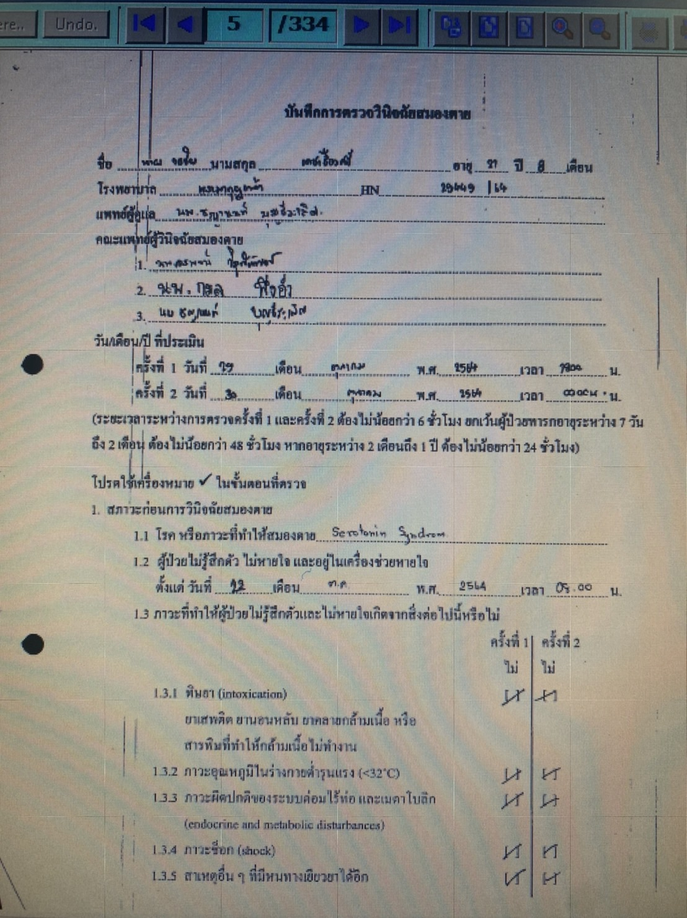
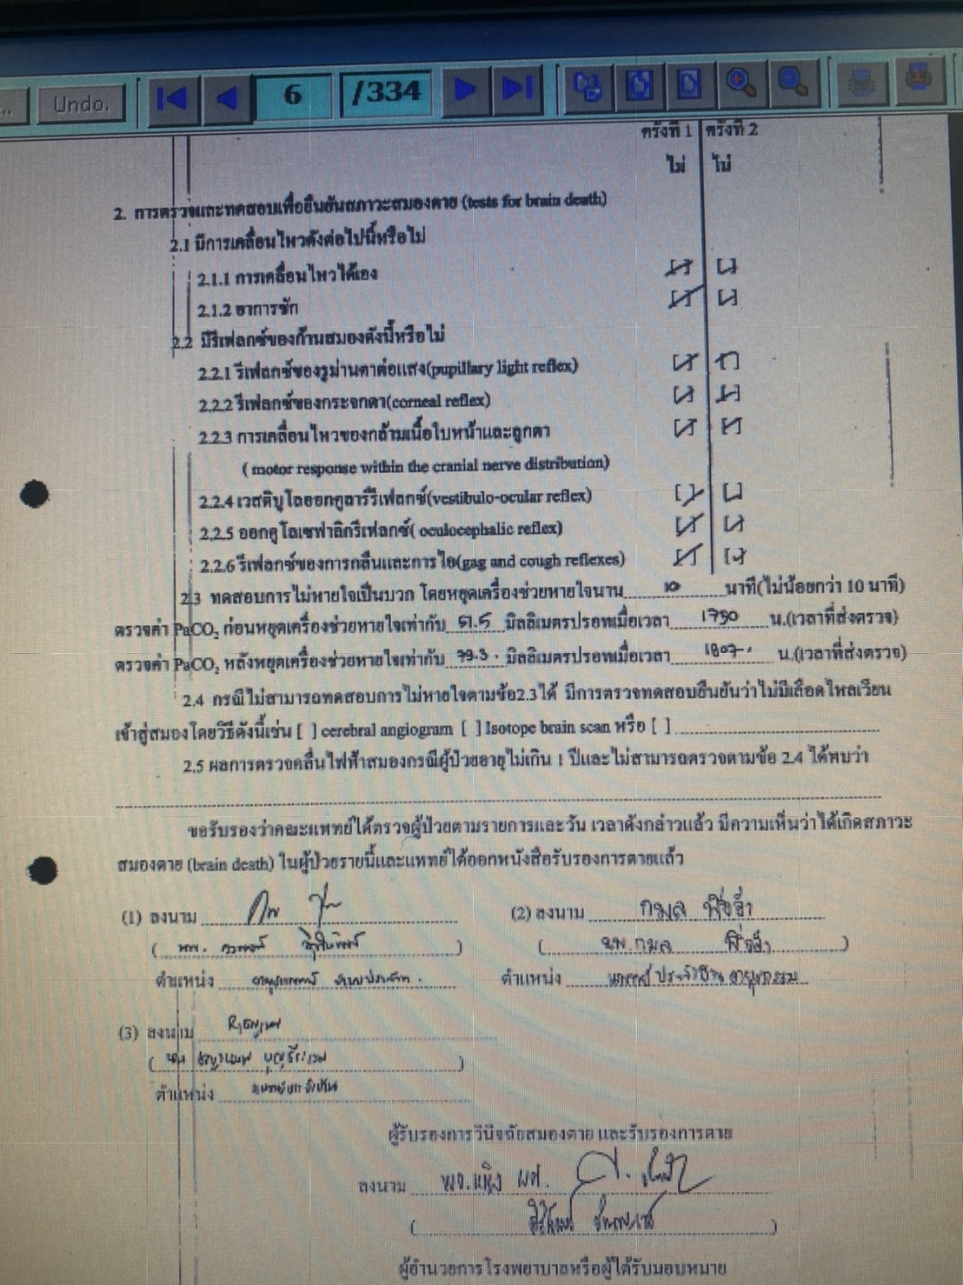

Slide 26
Investigation
CBC : Hb 8.4 g/dl, Hct 26 %, Plt 279,000 /ul, WBC 26,400 /ul, PMN 94%, Lym 3 %, Mono 3%
Bun/Cr : 24.8 mg/dl, 0.54
eGFR : 150 ml/min/1.73m²
Electrolytes: Na 147.8 mEq/L, K 3.2 mEq/L, Cl 115.5 mEq/L, HCO3 22.7 mEq/L
LFT : TP/Alb : 5.61 g/dl/2.81 g/dl, TB/DB : 5.31 mg/dl/4.32 mg/dl, AST/ALT : 116 U/L/164.7 U/L, ALP 157 U/L
Coagulogram : PT/INR : 16/1.07 , APTT : 34/1.36 , TT : 22/2.01
BS : 107 (06:00)
ABG : pH 7.32, pO2 480 mmHg, pCO2 49.4 mmHg, Na 146 mmol/L, K 3.11 mmol/L, HCO3 24.9, Ca 4.52 mg/dl, BE -1.2 mmol/L, ETCO2 26.4 mmol/L, FiO2 100 %, O2 sat 99.8 %

Slide 27
Investigation
UA : Y/C, Sp. Gr. 1.013, pH 6, Sp gr. 0-1, WBC 5-10, RBC 2-3, Bacteria few, Glucose Trace, Protein Trace
Sputum G/S : Few PMNs, Moderate Gram negtive bacilli, Moderate Gram positive cocci
Urine G/S : Few PMNs, no organisms

Slide 28
Investigation
Anti-HBc IgG : Neg
HBsAg : Non-reactive
HBeAg : Non-reactive
Anti-HBs : Positive
Anti-HBe : Negative
Anti-HBC IgM : Negative
Anti-HCV : Non-reactive
Anti-HBc IgG : Negative
Anti-HAV IgG : Positive
Anti-HAV IgM : Negative
Anti-HBC IgM : Neg
CMV IgM : Neg , CMV IgM : 0.4 (0-0.9)
CMV IgG : Positive, CMV IgG : 7.3 (0-0.8)
VDRL : Non-reactive, Anti-HIV : Negative

Slide 29
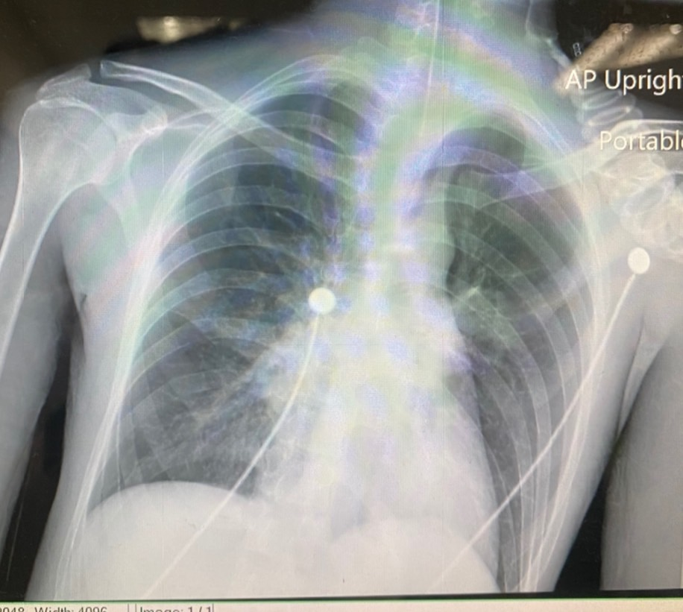
CXR 30/10/2564

Slide 30
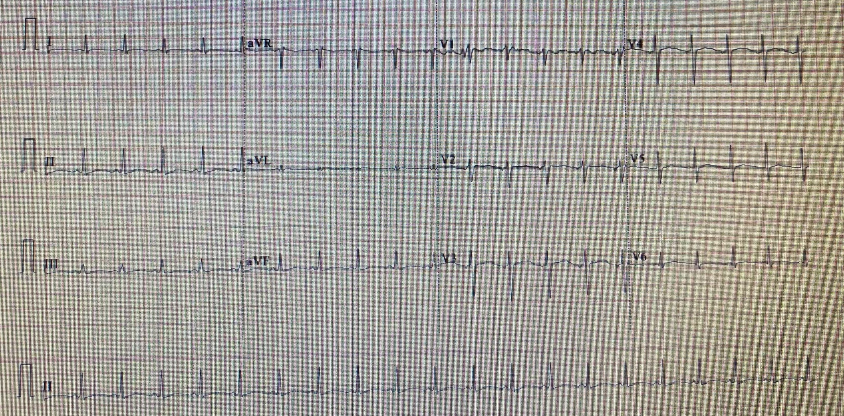
EKG 23/10/2564

Slide 31
Echocardiogram 29/10/2564
Normal LV size, Good LV systoic function, LVEF 50-55%, no RWMA, normal LV wall thickness.
Normal RV size and good RV systolic function.
Mild MR, Mild TR.
No significant valvular pathology.

Slide 32
EEG 26/10/2564
Impression & Clinical correlation
The electroencephalographic finding was abnormal and consistent with very severe diffuse encephalopathy.
No epileptiform discharge or EEG seizure was seen.

Slide 33
R1 Problem list & ASA classification

Slide 34
Problem list
Severe serotonin syndrome with multi-organ failure with brain death

Slide 35
ASA
6 E

Slide 36
R2 preoperative evaluation & preparation

Slide 37
Preoperative evaluation
Patient factor
Surgical factor
Anesthetic factor

Slide 38
Patient factor
Severe serotonin syndrome
Neurogenic pulmonary edema
Brain death

Slide 39
Severe serotonin syndrome

Slide 40
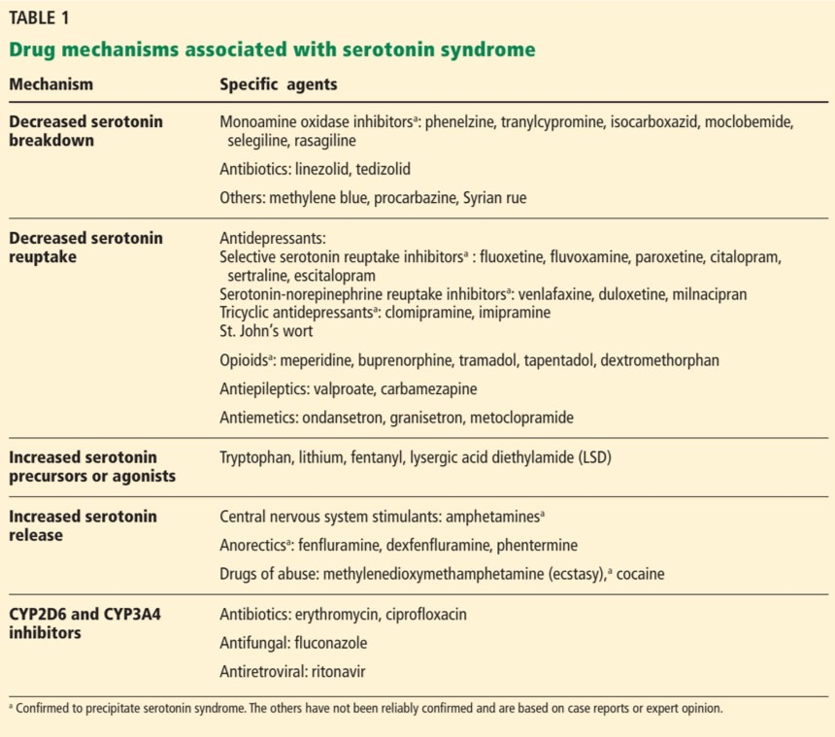

Slide 41
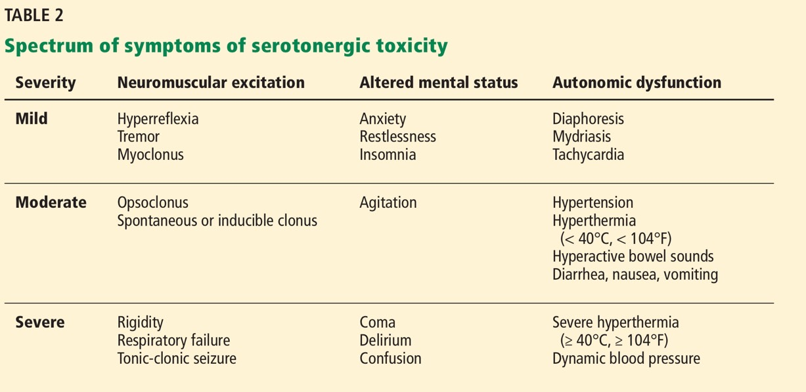

Slide 42
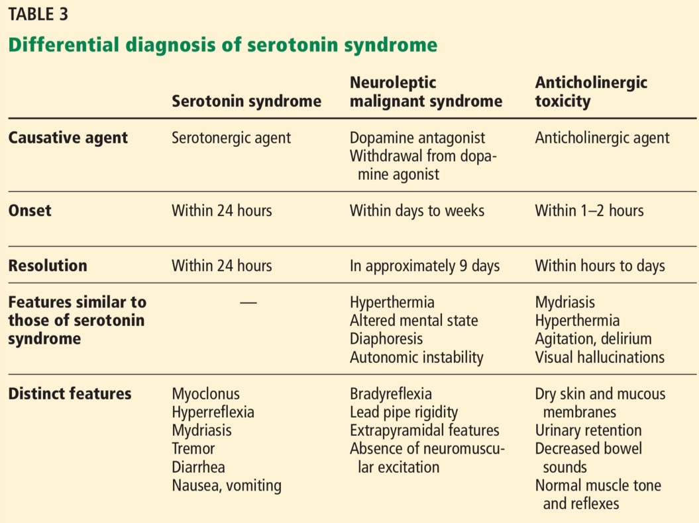

Slide 43
Treatment
Mainstays of management: stop the serotonergic agent and give supportive care

Slide 44
Serotonin antagonists
Cyproheptadine :
Potent 5-HT2A antagonist
Chlorpromazine :
5-HT1A and 5-HT2A antagonist

Slide 45
Serotonin antagonists
Cyproheptadine : potent 5-HT2A antagonist
Usually respond within 1 to 2 hours of administration.
Signs and symptoms have resolved completely within times ranging from 20 minutes to 48 hours, depending on the severity of toxicity.
Initial dose : 12 mg, followed by 2 mg every 2 hours if symptoms continue.
Maintenance : 8 mg every 6 hours once stabilization is achieved.
The total daily dose should not exceed 0.5 mg/kg/day.
Only oral form but can be crushed and administered via a NG tube.
Chlorpromazine : 5-HT1A and 5-HT2A antagonist and can be given intramuscularly.
Side effects : Hypotension, dystonic reactions, and neuroleptic malignant syndrome

Slide 46
Other agents
Benzodiazepines : mainstay for symptomatic relief because of their anxiolytic and muscle relaxant effects.
Neuromuscular blocking agents.
The suggested neuromuscular blocking agent for severe toxicity is a nondepolarizing agent such as vecuronium.
Succinylcholine should be avoided -> exacerbate rhabdomyolysis and hyperkalemia.
Physical restraints can exacerbate hyperthermia and lactic acidosis in agitated patients.

Slide 47
Neurogenic pulmonary edema

Slide 48
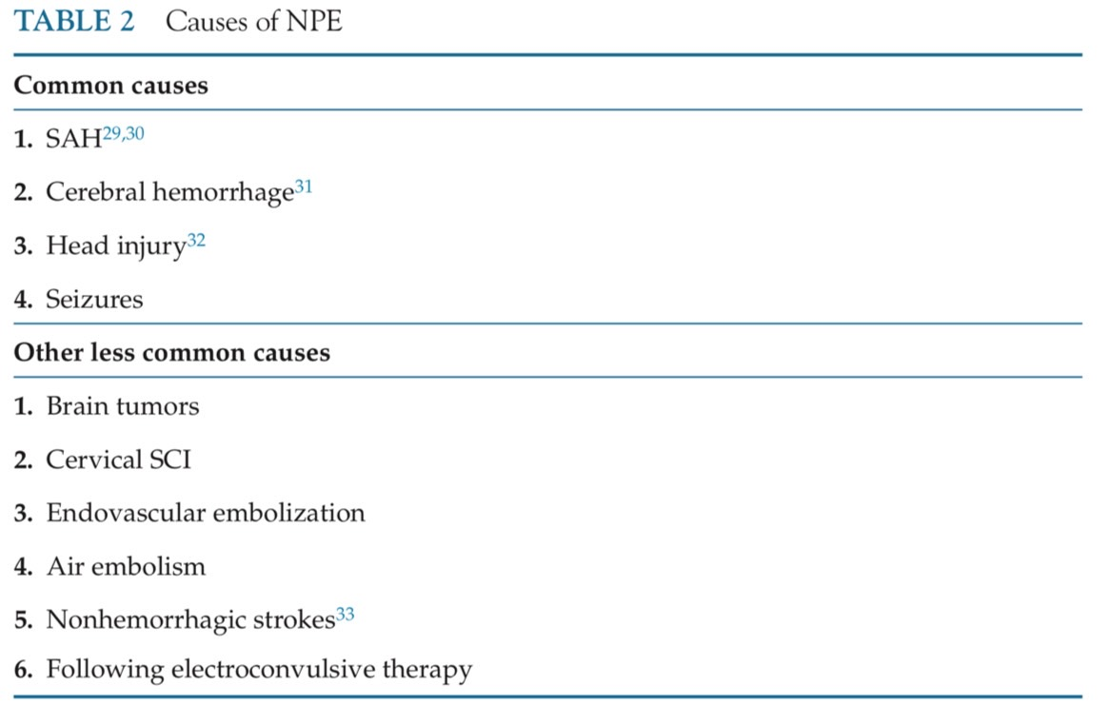
Neurogenic pulmonary edema

Slide 49
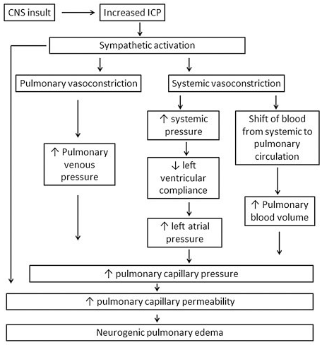

Slide 50
Management
Airway and breathing:
Lung protective ventilation
Higher PEEP (>10 cmH2O)
should be avoided in patients with signs of raised ICP.
Permissive hypercapnia
should be avoided in patients with raised ICP.

Slide 51
Management
2. Circulation:
Cardiac index > 2.5 L/min/m2 & SVR < 1000 dynes/sec/cm⁵
Dobutamine : 1st line for maintenance of cardiac index and SVR.

Slide 52
Brain death

Slide 53
Physiological change
CVS
Respiratory
Metabolic
Renal
Hematologic

Slide 54
CVS
2 phases :
Catecholamine storm :
Increased ICP - compensatory arterial hypertension
-> marked sympathetic stimulation with intense vasoconstriction, raised systemic vascular resistance, and tachycardia
Marked hypotension :
After brain herniation is complete -> marked hypotension

Slide 55
CVS
Maintaining adequate intravascular volume
Fluid : Isotonic balance salt solution
No evidence demonstrates that a specific crystalloid solution is superior to another.
Adequate resuscitation( MAP 60 - 100 mmHg) :
decrease cytokine levels & increase organs availablility for transplantation.
Large doses of starch-based colloids :
should be avoided because they may be associated with DGF.

Slide 56
CVS
Dopamine : 1st line
Antiinflammatory and immunomodulatory effects.
If dopamine > 10 mcg /kg/min is required :
2nd vasoactive agent should be added.
Vasopressin : 0.5 - 2.4 international units/hour
Initial therapy of choice for potential heart donors by the American College of Cardiology.
Reduces catecholamine requirements & effective treatment for DI

Slide 57
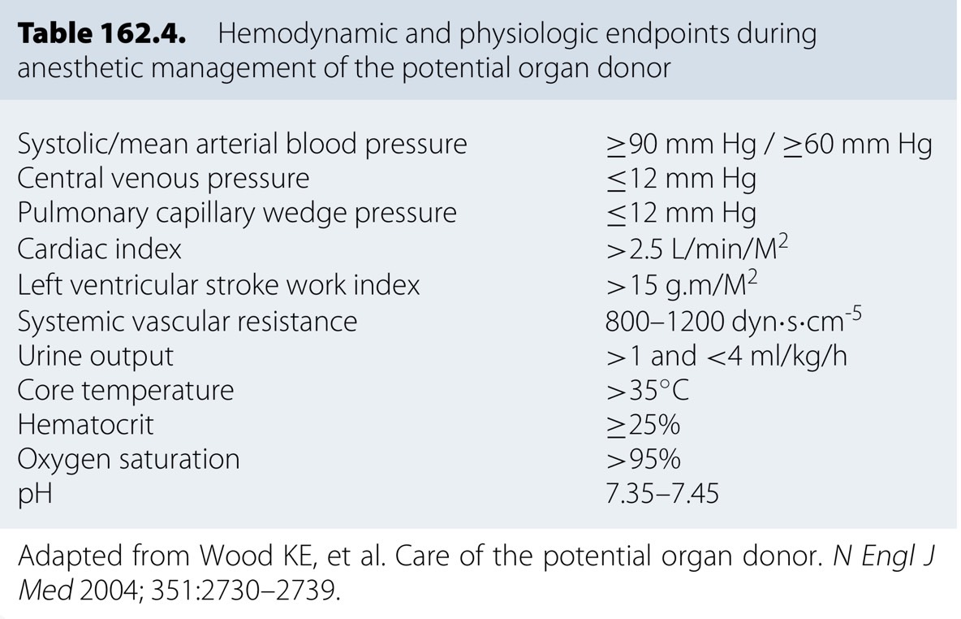
CVS

Slide 58
Respiratory
Lung-protective ventilation strategies :
TV 6-8 mL/kg of predicted body weight, PEEP 5-10 cm H2O
Least FiO2 to achieve :
arterial PaO2 > 100 mm Hg or oxygen saturation > 95%
RR to achieve arterial PaCO2 35 - 45 mm Hg.
Plateau pressures ≤ 30 cm H2O.

Slide 59
Endocrine
Thyroid replacement
Diabetes insipidus
Insulin resistance
Thermoregulation alteration

Slide 60
Thyroid replacement
Impairment of the hypothalamic-pituitary axis -> decreases anterior pituitary hormones
Meta-analysis : no clear benefit from the administration of thyroid hormone replacement
Thyroid replacement therapy should not be administered unless the patient has a history of hypothyroidism.

Slide 61
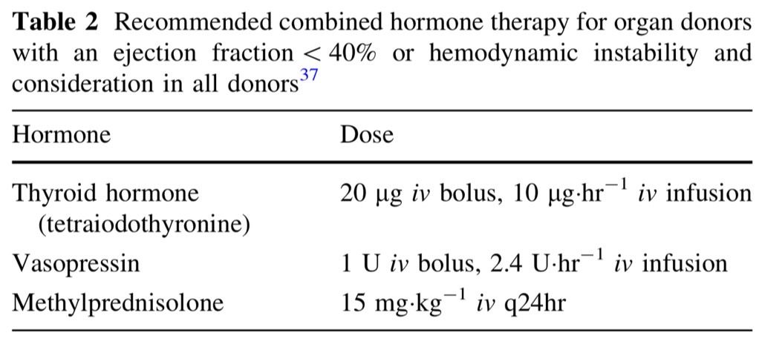
Thyroid replacement

Slide 62
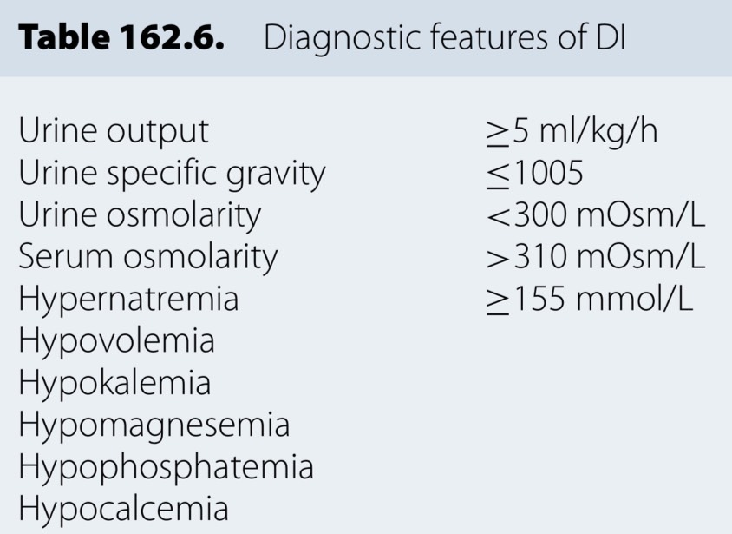
Diabetes insipidus

Slide 63
Diabetes insipidus
Approximately 80% of patients with brain death will develop DI due to the destruction of the posterior pituitary gland and the resultant ADH deficiency.
Treatment : DDAVP
Intravenous (IV), subcutaneous (SC), and intranasal administration.
The dose for SC or IV : 1 to 2 μg twice daily;
The dose for intranasal dose : ranges between 10 and 40 μg daily.
A continuous infusion of vasopressin can also be used to treat DI.

Slide 64
Insulin resistance : hyperglycemia
Release of epinephrine, exogenous steroid administration, or infusion of dextrose-containing solutions.
Lower rate of organ suitability for transplantation & decreased renal graft survival.
Serum glucose < 150 mg/dL or 8 mMol/L

Slide 65
Thermoregulation
Hypothalamic function and control of body temperature are lost.
Hyperpyrexia occur at first, then hypothermia follows.
Reduction in metabolic rate and muscle activity, in combination with peripheral vasodilatation.
Normothermia is recommended before and during procurement by using active warming devices.

Slide 66
Hematologic
Coagulopathy :
The release of tissue factor from injured cortical parenchyma -> coagulopathy & subsequent DIC
The release of cerebral gangliosides & plasminogen-rich substrates from damaged brain tissue

Slide 67
Hematologic
Targeting hemoglobin concentration of 9-10 g/dL & ≥ 7 g/dL in order to optimize oxygen delivery to organs.
Some guidelines : a mixed venous oxygen saturation of ≥ 60% in order to ensure appropriate oxygen delivery.

Slide 68
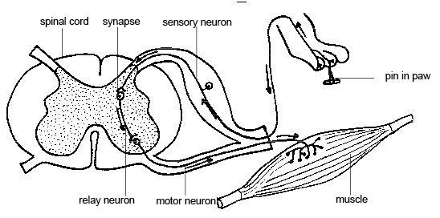
Muscle
The somatic movements are uninhibited spinally-mediated reflexes that occur in response to stimuli such as surgical incision or manipulation.

Slide 69
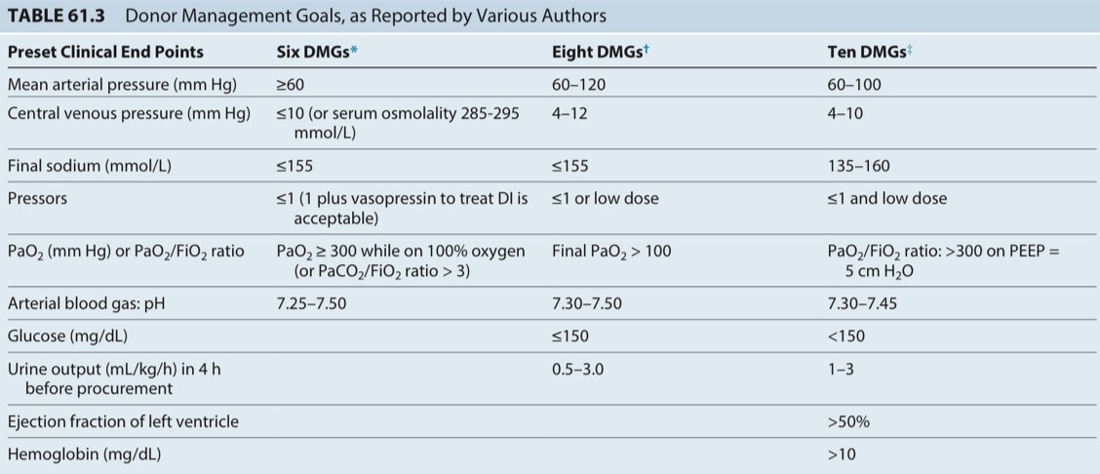

Slide 70
Surgical factor
Harvest organ : Heart and kidneys

Slide 71
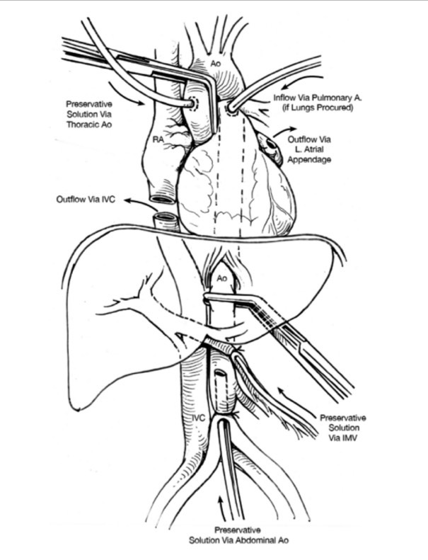

Slide 73
R3 Anesthetic consideration

Slide 74
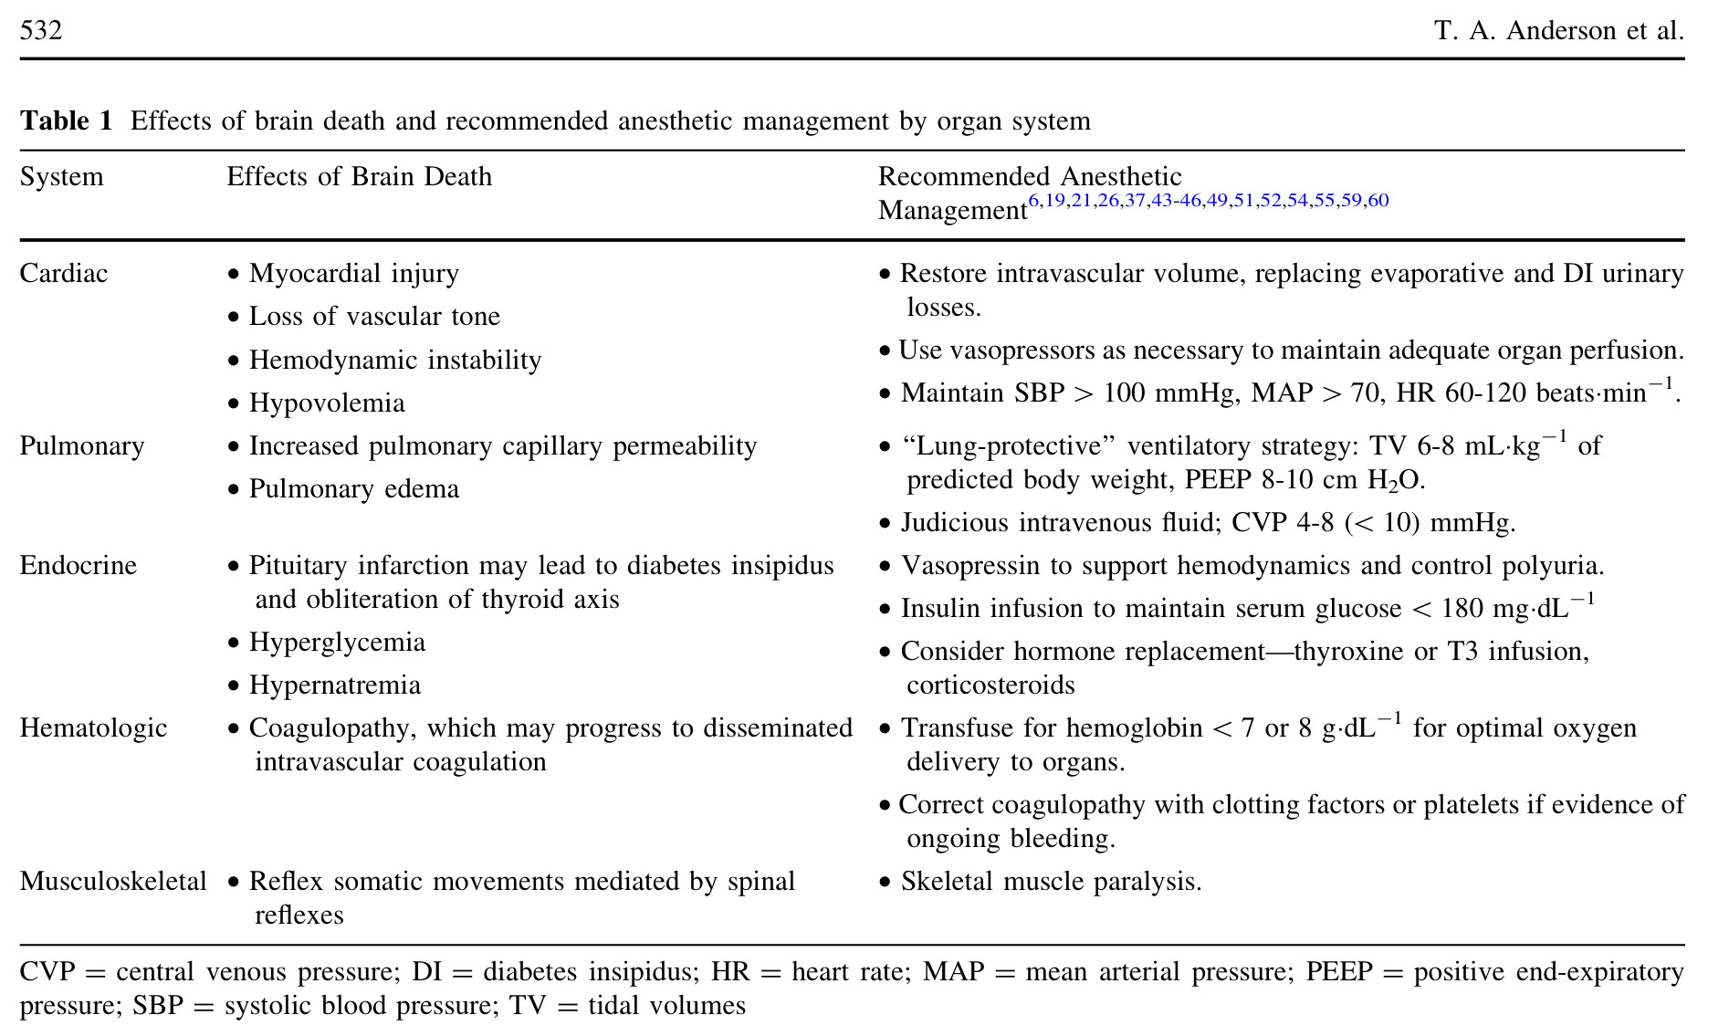
Anesthetic consideration

Slide 76
Organ procurement
Goal : maintenance of adequate oxygenation and perfusion of all organ systems
Time of notification to the OPO – Time of transport to OR
Donor status, Critical time points and ICU management

Slide 77
Transfer
Critical period.
Cardiac arrest : Goal -> immediate organ recovery rather than ROSC or stabilization of hemodynamics.
CPR objective : maintain blood flow to organs -> heparin is administered -> organ recovery expedited
Ventilator setting in the ICU should be the same during transfer and in the OR.

Slide 78
Organ recovery
Time of OR arrival – Warm ischemic time at a recipient
Standard & specific monitoring( A-line ± C-line )

Slide 79
Organ recovery
During procurement surgery
Spontaneous spinal reflex -> movements : NMBAs
Surgical stimulation -> catecholamine release and hypertension : volatile anesthetics >> vasodilators, opioids
Volatile anesthetics : ischemic preconditioning and the reduction of ischemia-reperfusion injury.

Slide 80
Organ recovery
Crystalloid > colloid : Isotonic balanced salt solution
Avoid hydroxyethyl starch -> renal tubular injury and hypernatremia
Dopamine : First choice
At <5 μg/kg/min -> improve organ survival
10 μg/kg/min : upper limit
Epinephrine : Dopamine has reached higher limit
Vasopressin : treat DI and reduces need for catecholamines

Slide 81
Organ recovery
Significant bradycardia in neurologic-dead donors does not respond to atropine -> a direct-acting chronotrope such as isoproterenol.
Heparin 300 IU/kg : before cross-clamping the aorta
As soon as the organs are perfused with the cold solution, mechanical ventilation and anesthesia care can be stopped.

Slide 82
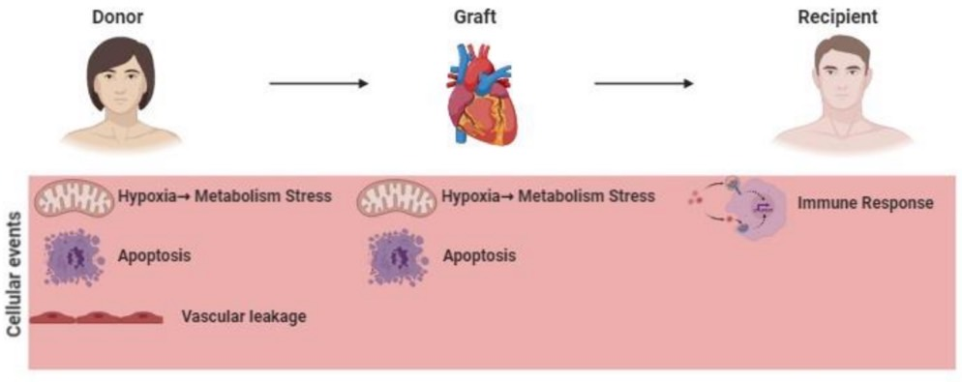
Ischemic reperfusion injury

Slide 83
Cold ischemia times
24 hours for the kidney
12 hours for the liver
6 hours for the heart
4 hours for the lung

Slide 84
Preservative solution
Various cold-storage solutions are used world-wide with the UW solution one of the most widely used.
The University of Wisconsin (UW) solution :
high potassium and adenosine to supply ATP during cold storage.
Histidine-tryptophan- ketoglutarate (HTK) solution:
originally developed for cardioplegia & applied to organ preservation.
Organ-specific solutions :
Perfadex solution : Lung
Celsior solution : Heart

Slide 85
Preservative solution
Custodiol HTK solutions :
15 mM sodium, 9 mM potassium, 4 mM magnesium, 15 lM calcium, 1 mM ketoglutarate, 198 mM histidine, 30 mM mannitol, 2 mM tryptophan
Celsior solution :
100 mMol􏰀L-1 sodium, 15 mMol􏰀L-1 potassium, 13 mMol􏰀L-1 magnesium, 0.25 mMol􏰀L-1 calcium, 80 mMol􏰀L-1 lactobinate, 3 mMol􏰀L-1 glutathione, 20 mMol􏰀L-1 glutamate, 60 mMol􏰀L-1 mannitol, 30 mMol􏰀L-1 histidine
University of Wisconsin (UW) solution :
100 mM potassium lactobionate, 25 mM KH2PO4, 5 mM MgSO4, 30 mM raffinose, 5 mM adenosine, 3 mM glutathione, 1 mM allopurinol, 50 g􏰀L-1 hydroxyethyl starch

Slide 87
Choice of anesthesia
GA with ETT with controlled ventilation

Slide 88
Preparation

Slide 89
General preparation
NPO
Informed consent
Anesthetic machine
Intubation equipment
Force air warmer
Warm IV fluids
Antibiotics
IV anesthetic drugs
Large bore IV

Slide 90
Specific preparation
Heparin
Inotropes and vasopressor
Dopamine, Epidephrine and Levophed
Vasopressin
Methyprednisolone
Tetraiodothyronine
Insulin

Slide 91
Intraoperative monitoring
Non-invasive
NIBP
5 lead EKG
Pulse oximeter
Urine output
Body temperature
Invasive
A-line
C-line : Only for vasoactive agents administration

Slide 92
Intraoperative

Slide 93
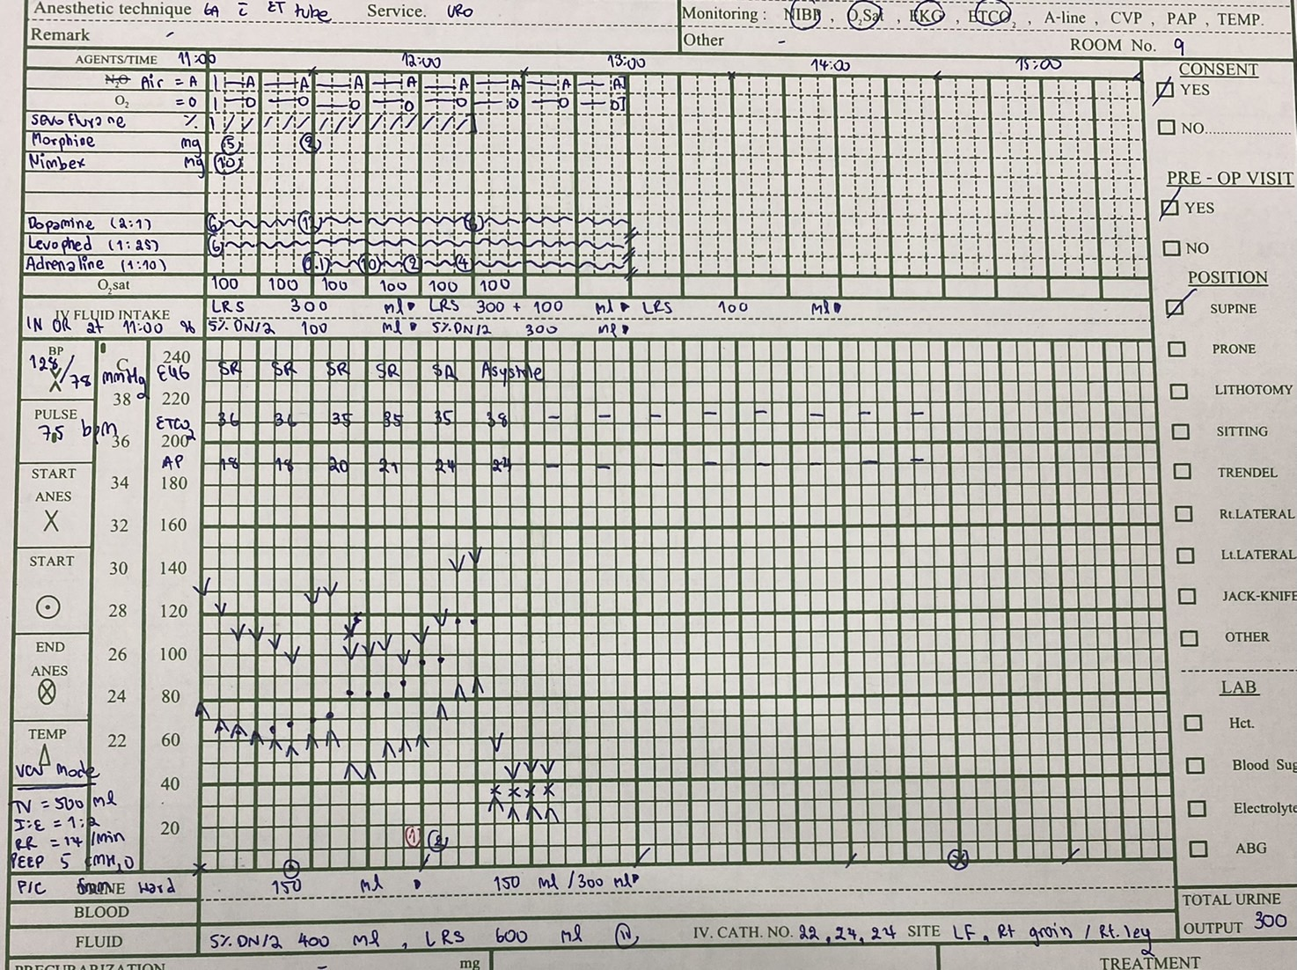
In OR at 11:00
Monitor : NIBP, 5-lead EKG, O2 sat, ETCO2, Urine output
V/S : BP 128/78 mmHg, PR 75 bpm, O2 sat 100 %
Ventilator setting VCV: TV 500 ml, RR = 14 /min, I:E 1:2, PEEP 5 cmH20
IV : 22,24,24 at Left foot, Right groin, Right leg
5%DN/2 ยกมา 400 ml, LRS ยกมา 600 ml
Vasopressor :
Levophed (1:25) IV 0.66 mcg/kg/min
Dopamine (2:1) IV 4.17 mcg/kg/min

Slide 94
At 11:05
Induction O2 100 % 6 LPM, Sevoflurane 1 %
Muscle relaxant : Nimbex 10 mg IV
Opioid : Morphine 5 mg IV
Position : Supine

Slide 95
Start operation at 11:25
BP 98/60 mmHg, PR 68 bpm

Slide 96
Start operation at 11:25
Heparin 30,000 unit IV at 11:59
Median sternotomy was done at 12:05

Slide 97
CVT dissect heart (Aorta, IVC, SVC and PA) and applied cardioplegia needle
Uro dissect renal arteries & veins, bilateral iliac vein, ureter and bilateral kidneys
CVT clamp ascending aorta and infused HTK solution
Then SVC was ligated
IVC and Pulmonary vein were incised.
When 2,000 ml HTK was infused, clamp was removed.
Slush ice of acetar was placed in the thoracic and abdominal compartment to cool down the organs
Heart was resected
Then both kidneys was resected

Slide 98
Total operation time : 3 hours 30 min
Total IV intake 1,200 ml
Urine output 300 ml
Blood loss 500 ml
Morphine 7 mg

Slide 99
Take home message

Slide 100
Thank you

